Slide 1


An Integrative Analysis of Time-varying Regulatory Networks from High-dimensional Data
Zi Wang¹, Yun Guo¹, Haijun Gong^{1,2}
¹Saint Louis University
²Australian National University
IEEE BigData Workshop
December 11, 2018
Notes:
1

Slide 2
Outline
Introduction
Network Inference
Model Checking
Application

Slide 3
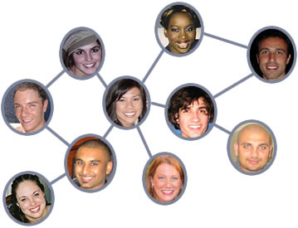
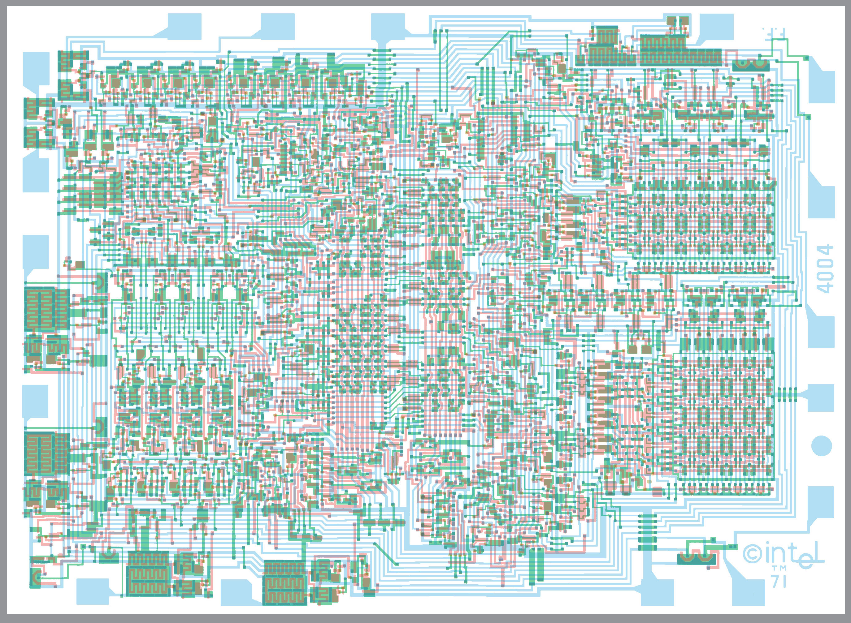
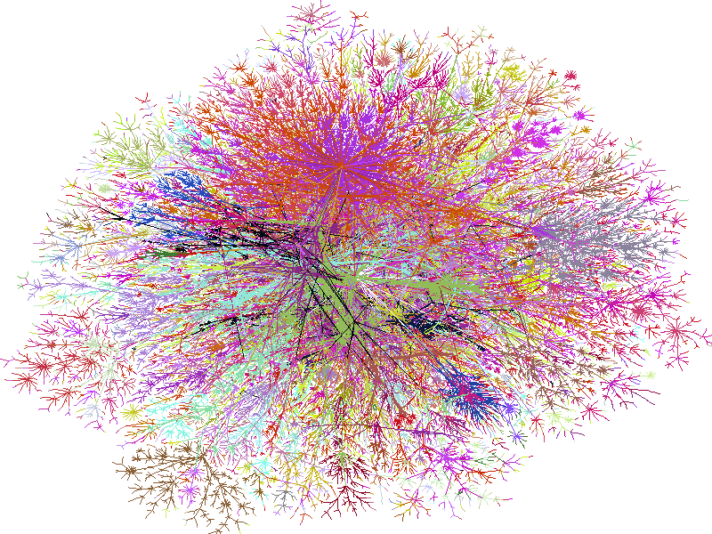
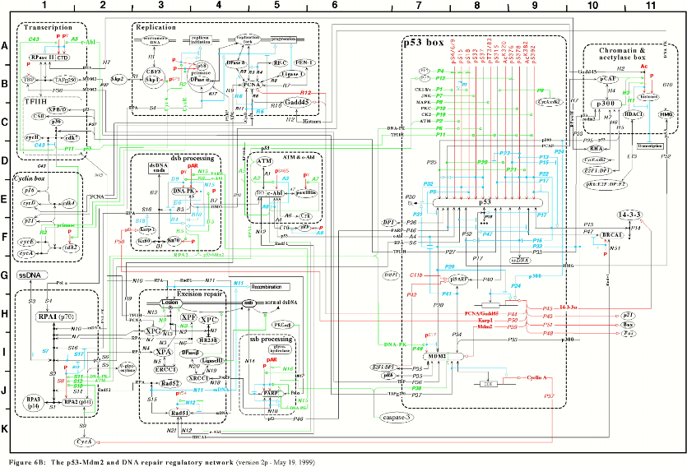
Networks exist everywhere
Social Network
Circuits
Internet
Cellular Pathways

Slide 4
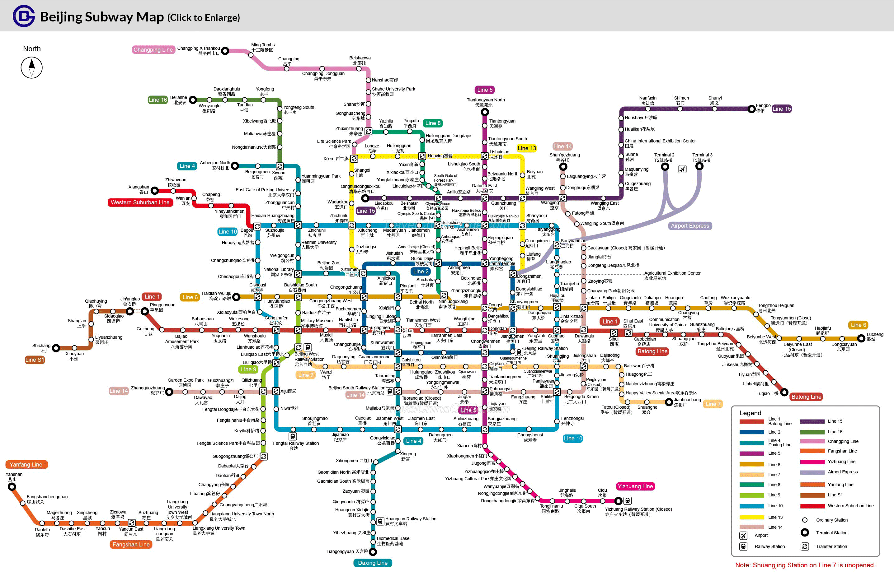
Subway Map
Beijing subway network has 15 lines and 217 stations

Slide 5
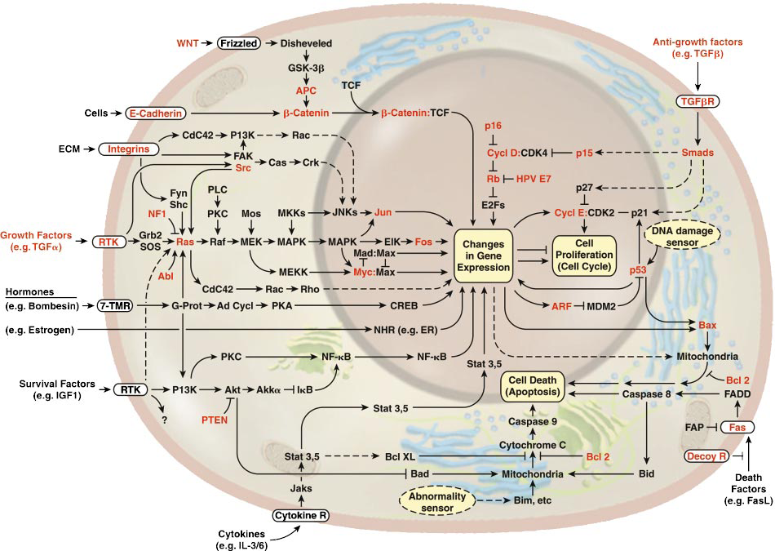
Subway Map of Cellular Pathways
D. Hanahan and R. A. Weinberg. Cell, Vol. 100, 57–70, 2000
Tens of signaling pathways and hundreds of proteins

Slide 6
Intel CPU
Digital circuits composed of millions of Gates

Slide 7
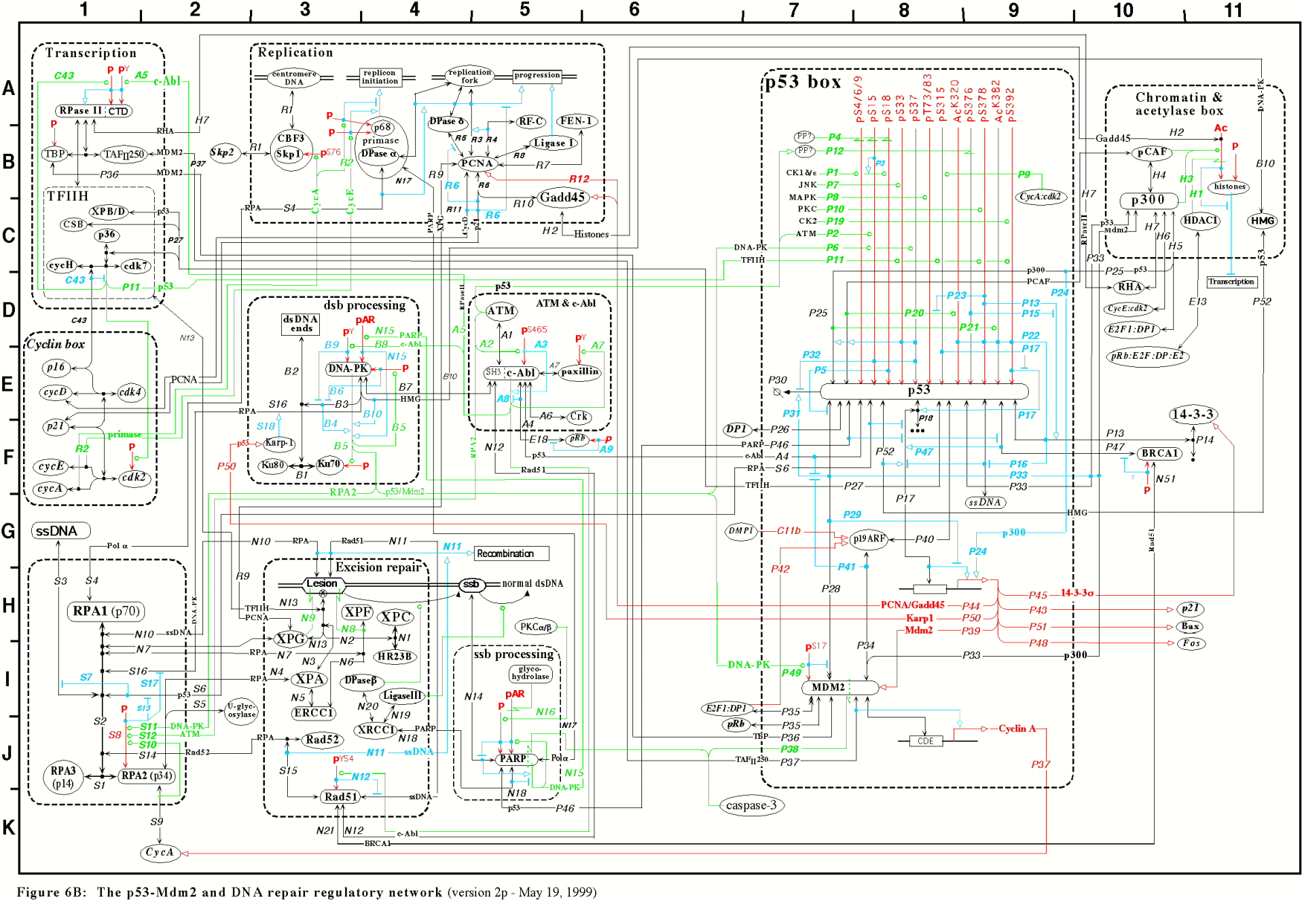
Gene Regulatory Sub-network
Genetic networks composed of thousands of genes

Slide 8
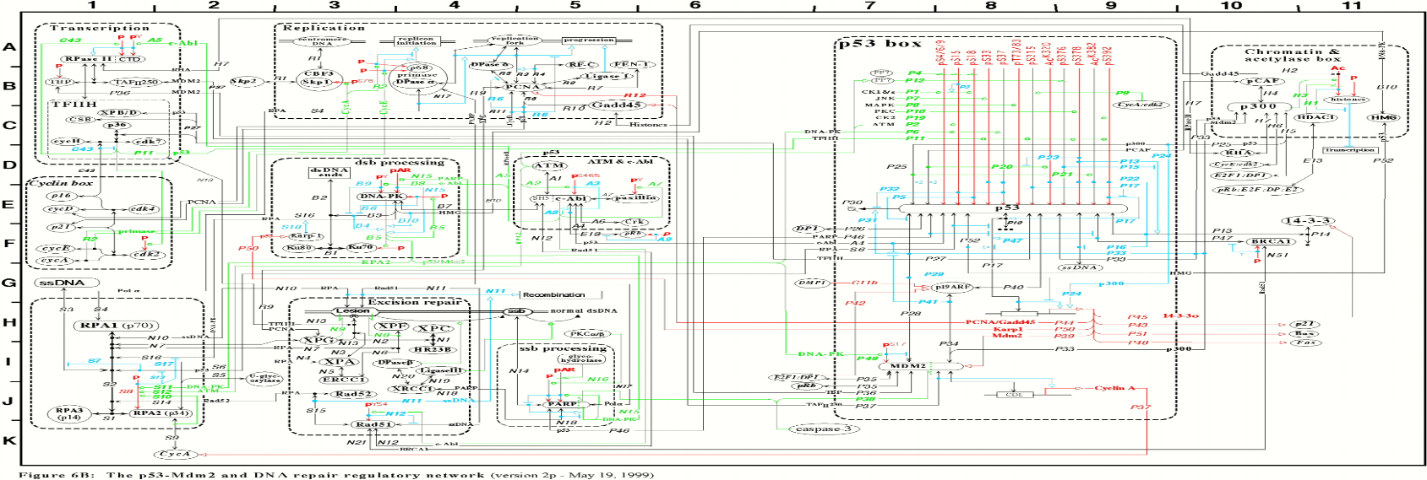
Challenges
Designed by Human
Designed by Creator
Question 1: How to reconstruct the biological network?
Question 2: How to verify the inferred network?

Slide 9
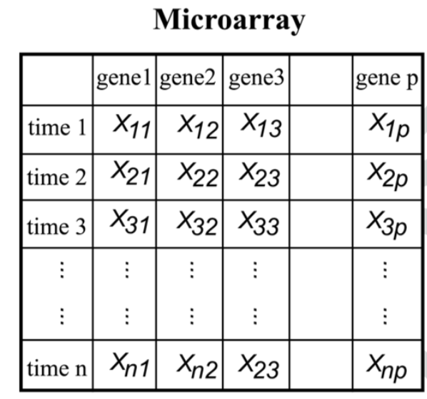
Biological Data and Graph
Biological (e.g., microarray) data can be divided into two types: static and time series.
Probabilistic Graphical Model: node (random variable) & edges (probabilistic dependencies)
(a) Undirected Graph
(b) Directed acyclic graph (DAG)
(c) Directed graph with cycles
(d) Regulatory Network
A
F
A
F
B
G
B
G
C
H
C
H
D
E
D
E
(a)
(b)
A
F
w1
A
F
B
G
B
G
w2
C
H
C
H
D
E
D
E
(c)
(d)

Slide 10
Correlation Networks (undirected)
Correlation networks, e.g., Co-expression networks
Nodes are genes, edges represent correlations between expression levels of connected nodes
Nodes are connected if they have a significant pairwise association
Reference: WGCNA (weighted gene co-expression network analysis) (Zhang, Horvath)
Correlation matrix
C
H
 | A | B | c | D | E | F | G | H
A |  | 0.91 | 0.72 | 0.84 |  | 0.78 | 0.88
B | 0.91
C | 0.72
D | 0.84
E |  |  |  |  |  | 0.94
F | 0.78 |  |  |  | 0.94 |  | 0.75
G | 0.88 |  |  |  |  | 0.75 |  | 0.92
H |  |  |  |  |  |  | 0.92
A
Correlation threshold,
τ=0.7
G
B
F
D
E

Slide 11
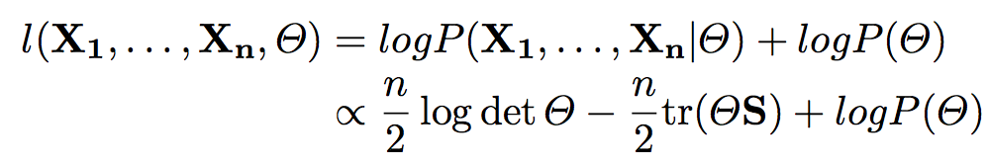
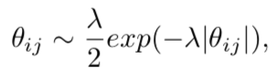
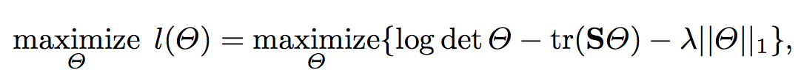
Graphical Lasso (undirected)
Assumption: X1, ..., Xn ~ N(μ, Σp), where Σp is p × p covariance matrix.
Inverse of Σ is called precision matrix Θ: represents the conditional independence and dependence relationship among the variables.
Graphical lasso method builds undirected graphs by penalizing the off-diagonal elements of Θ with an L1 norm.
Laplace Distribution

Slide 12
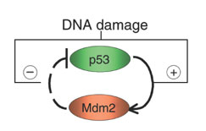
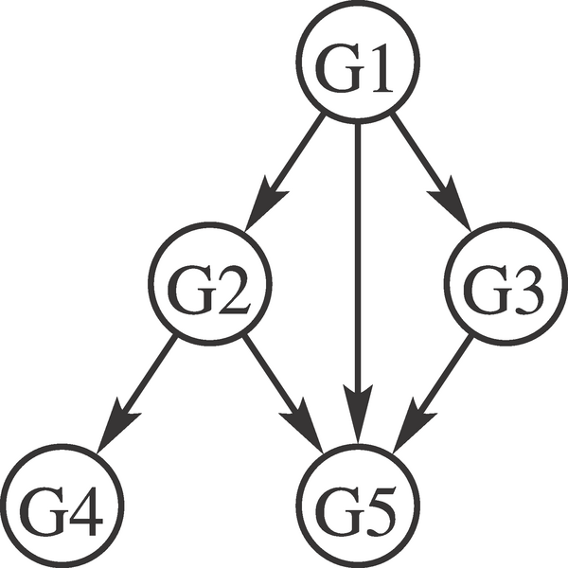
Bayesian Network (Directed & Acyclic)
Bayesian Network (BN) is a directed acyclic graph (DAG)
Conditional distribution:
where q is any set of nodes other than its successors,
Conditional Independence: each node is independent of its non-descendants given its parents
Directed edge stands for the regulation of one
node by another.
Joint probability distribution of the network:
E.g., p(G1, G2, G3, G4, G5)
= p(G1) p(G2|G1) p(G3|G1) p(G4|G2) p(G5|G1, G2, G3)
Limitation: No feedback loop! temporal information

Slide 13
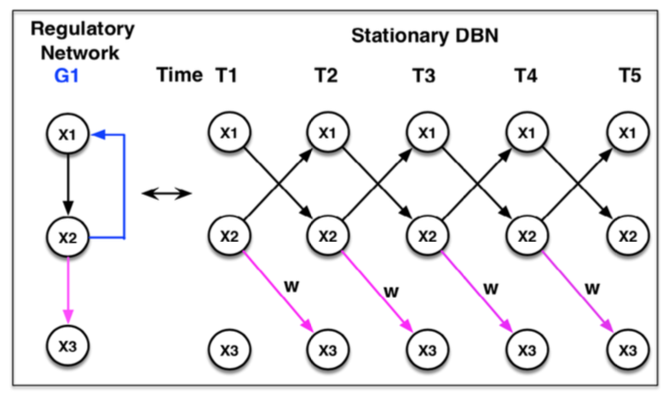
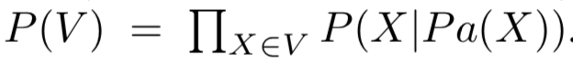
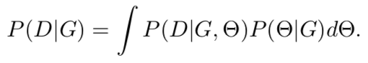
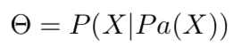
Stationary Dynamic Bayesian Network
Dynamic Bayesian network assumes first-order Markov chain: each random variable at time t is only dependent on its parents at time t−1:

Slide 14
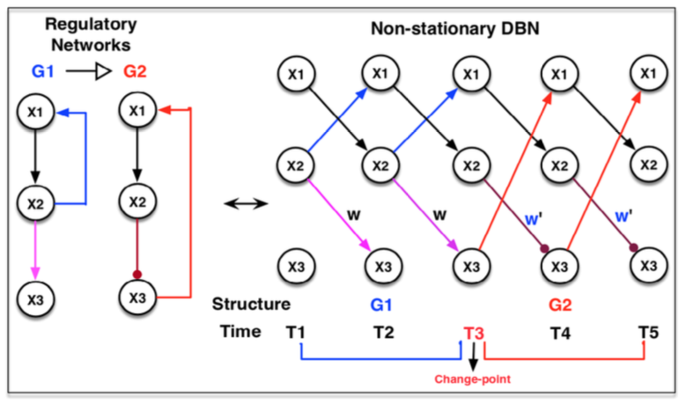
Time-varying Regulatory Network

Slide 15
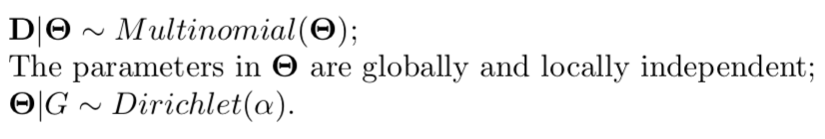
Structure Learning
Bayesian Dirichlet equivalence (BDe) metric
Bayesian Information Criteria (BIC)
BIC(G) = logP(G|D)− f(N)|G|
DBN-based Mutual Information Test (MIT) Score
DBN-based K2 Score.
…
Notes:
measures the goodness-of-fit of a network by the mutual information between a parent set and its child, penalized by a term which quantifies the degree of statistical significance of the shared information
The K2 algorithm, originally used to learn BN structure [53], assumes that a node has no parents in the beginning, then adds the parent from a given ordering whose addition will increase the score of the resulting structure the most. No parents will be added to the node when the score stops increasing.

Slide 16
Network Searching Algorithms
Greedy Hill Climbing Algorithm:
Generate an initial network, and set it as the current DBN;
Repeatedly apply single edge operation: addition, deletion, reversal, until finding a locally optimal network;
Local maximum problem!!
Simulated annealing algorithm :
Generate and set a current DBN;
Evaluate the scores of DBN’s neighbors;
Go to the neighbor DBN of highest score with a probability p, or walk to a neighbor with a
probability 1-p (random walk) to escape from a local maximum.
…

Slide 17
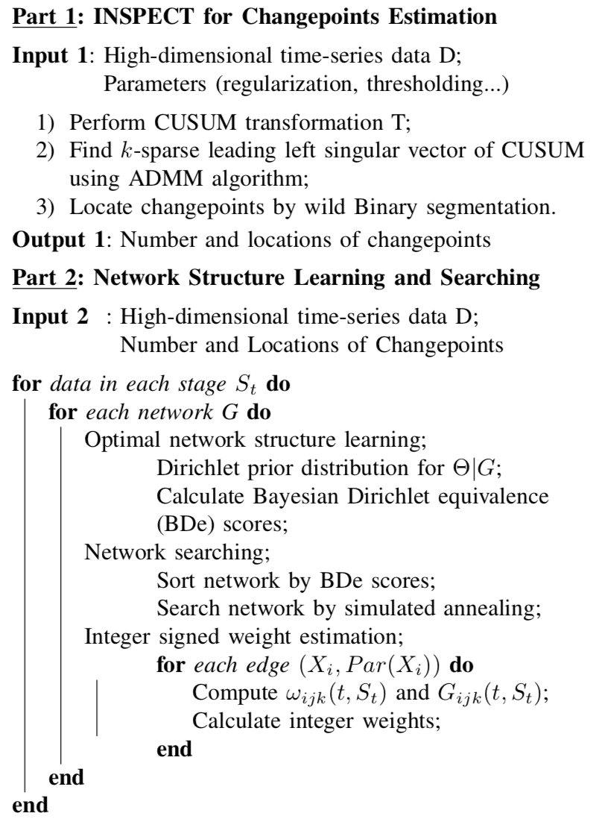
Time-varying Network Inference
Notes:
Di’rik’’lei

Slide 18
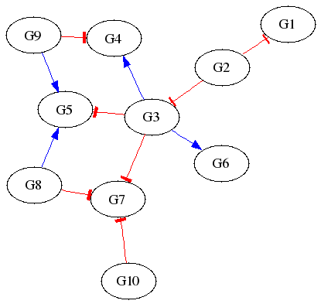
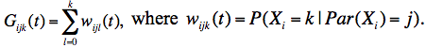
Integer Weight Estimation
Regulatory network requires activation & inhibition information.
Weight estimation method
For a given gene Xi , we perturb the expression levels of its parent gene, denoted by Par(Xi), estimate
G(t) is the probability that, at time t, gene Xi takes a value no more than k given its parents gene Par(Xi ) taking a value of j.
If there is a high probability for the gene Xi taking a larger value given its parent’s value increases, it will be voted as an activation event, else inhibition.
Notes:
Di’rik’’lei

Slide 19
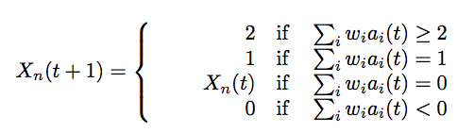
Discrete Value Model
Each node represents a regulatory component.
State (expression level) of each node takes discrete values at any time: {0,1,...,n-1}, namely, 0=inhibited,..., n-1=overexpressed.
The evolution (state update) of each node from time t to t+1 is described by a discrete state transfer function, which is regulated by its parents.
State of each node can take n possible values {0,1,...,n-1}, so the network with m proteins has n^{m} possible states.
Challenge: n^{m} is an astronomical number if m is large.
It is time-consuming and not realistic to analyze such a large network using traditional method.
07/16/09
07/16/09
07/16/09
07/16/09

Slide 20

Model Checking
Model checking is an automatic verification technique for the hardware systems (digital circuits, CPU).
Developed independently by Clarke and Emerson and by Queille and Sifakis in early 1980’s, 2007 Turing Award.
Model checking is the process of determining whether or not a given model M satisfies a desired property – ƒ written in temporal logic.
Model Checking Problem: Give a desired property ƒ, a Model/System M with initial state s, decide M, s |= ƒ.
Verification procedure is an intelligent exhaustive search of the state space of the model.
Clarke EM, Grumberg O, Peled DA: Model Checking. MIT Press 1999

Slide 21

Intel Pentium FDIV Bug
66MHz Intel Pentium
with the FDIV bug
Thomas R. Nicely (mathematician at Lynchburg College) found a bug in the 94’s Intel Pentium
Try 4195835 – 4195835 / 3145727 * 3145727 = ?
Should return 0
But, In 94’ Pentium, it returns 256.
Five entries are missing in the lookup table used by the floating point division algorithm
Cost: $500 million

Slide 22

Model Verification
Model: Program or circuit
Specification/Property
State Transition System
Temporal Logic Formula
(CTL, LTL, etc.)
Safety Property:
bad state unreachable:
Initial State
Model Checker
Satisfied / True !

Slide 23
Model Falsification
Model: Program or circuit
Specification/Property
State Transition System
Temporal Logic Formula
(CTL, LTL, etc.)
Safety Property:
bad state unreachable?
Initial State
Model Checker
Not Satisfied / False !

Slide 24
Counterexamples
Temporal Logic Formula
(CTL, LTL, etc.)
Safety Property:
bad state unreachable?
Initial State
Model Checker
Not Satisfied!
Counterexample
Initial State

Slide 25
LTL - Linear Temporal Logic
Linear Time Logic operators: X, F, G, U …
Atomic Propositions;
Boolean Operations ( Not ¬(!), And ˄(&), Or ˅(|) )
For example, a = (p1 > p2) ˄ !(p3 > p4)
a “a is true now”
a
X a “a is true in the neXt state”
a

Slide 26
LTL - Linear Temporal Logic
Fa “a will be true in the Future”
a
Ga “a will be Globally true”
a
a
a
a
a
Complexity of Model Checking:
LTL algorithm O(|M|∙2^{|f|})
a U b “a will hold true Until b becomes true”
a
a
a
a
b

Slide 27
Branching Time
Computation Tree
State Transition Graph
Unwind
Path quantifiers:
A: for all computation paths
E: for some computation path
CTL temporal operators: AX, AG, AF, AU; EX, EG, EF, EU
Computation Tree Logic (CTL)
Notes:
Ben-Ari, Manna, Pnueli

Slide 28
CTL: Computation Tree Logic
p
p
p
p
AF p: “p will necessarily
become true”
EF p: “p will possibly
become true”

Slide 29
CTL: Computation Tree Logic
p
p
p
p
p
p
p
p
p
p
EG p: “p is a potential
invariant”
AG p: “p is an invariant”

Slide 30

Symbolic Model Checking
Symbolic Model Verifier (SMV) is the first model checker based on ordered binary decision diagram (OBDD) to verify CTL property.
SMV can check up to 10¹⁰⁰ possible states!
Model
Model Checker
Model M
Discrete value /Boolean
M╞═ Φ
Symbolic
Model Checker
M╞═ Φ
CTL Formula
Φ
Counterexample
Experiment
KEGG, ...
Notes:
Clarke EM, Grumberg O, Peled DA: Model Checking. MIT Press 1999

Slide 31
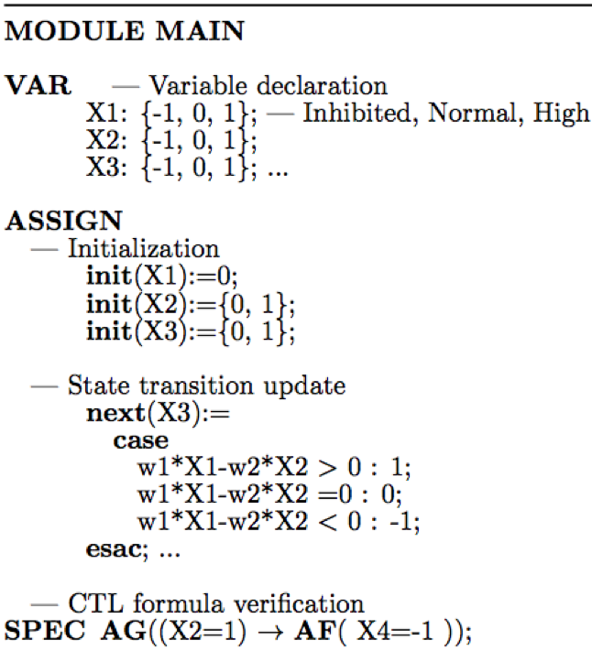
Weighted Symbolic Model Checking
X1
SMV code has 3 parts:
VAR:
declare variables
ASSIGN:
“init” defines the initial states; “next” update the state transition of the model
SPEC:
Each property is encoded as a CTL formula
w1
X3
w2
X2

Slide 32
Weighted Symbolic Model Checking
SMV code has 3 parts:
VAR:
declare variables
ASSIGN:
“init” defines the initial states; “next” update the state transition of the model
SPEC:
Each property is encoded as a CTL formula
X1
w1
X3
w2
X2

Slide 33

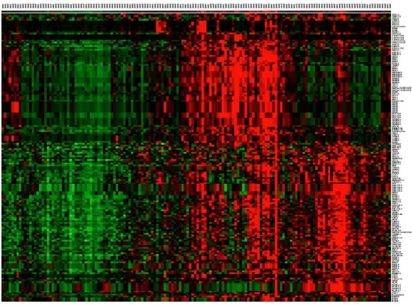
Integrative Network Inference & Verification
Statistical Inference
Algorithms
Experiments
Optimal
Network Candidates
Model
Checking Technique
Mathematical Modeling
Temporal Formula
Networks
Satisfy
Formula!
X
Discarded

Slide 34
Application
Data: Microarray Data of Drosophila (fly) during its life cycle from the embryonic, larval, and pupal to adulthood:
4028 genes, 67 time points during 4 stages.
1st step: Estimate the number and locations of change-points
2nd, infer regulatory networks at different stages
3rd, abstract some properties into temporal logic formula
4th, Model checking of the inferred networks

Slide 35
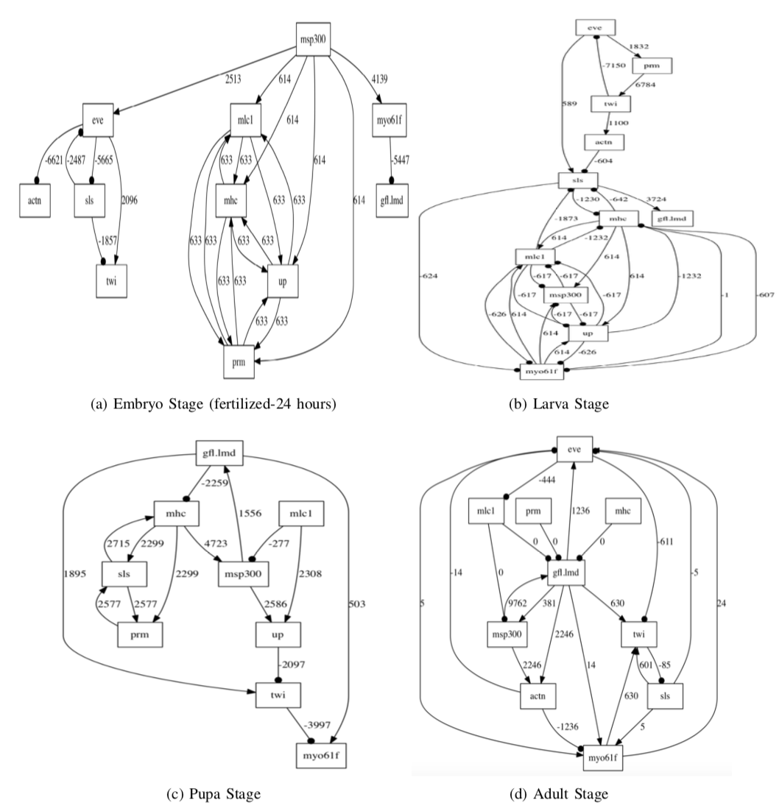
Time-varying Network Results

Slide 36
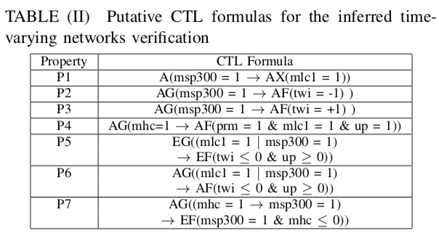
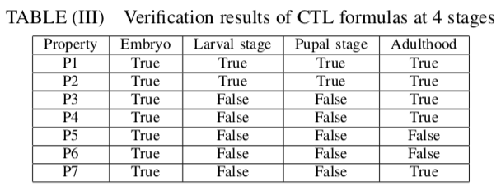
Network Verification Illustration

Slide 37
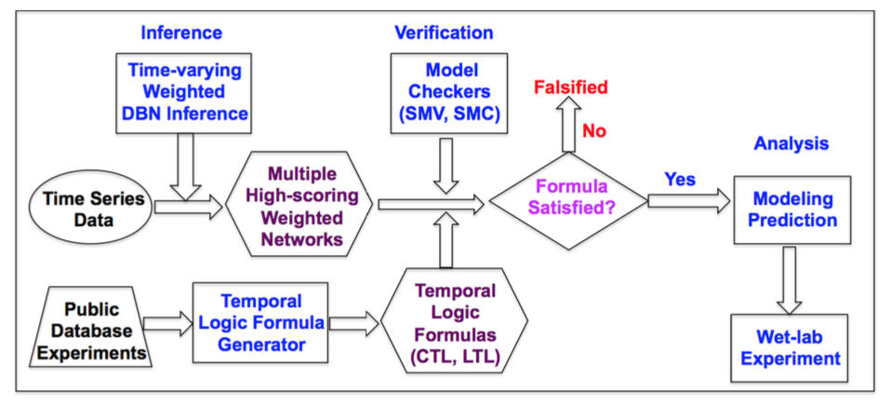
Current Work
The preliminary studies indicate that network structures are not independent at different stages.

Slide 38
Acknowledgement
The current time-varying network reconstruction project is funded by NIH.
Australian National University’s 1-year fixed term position during my sabbatical leave.
The 1st author, Ms. Zi Wang, is currently applying for the graduate program in Statistics/Biostatistics or Data Science.

